Slide 1
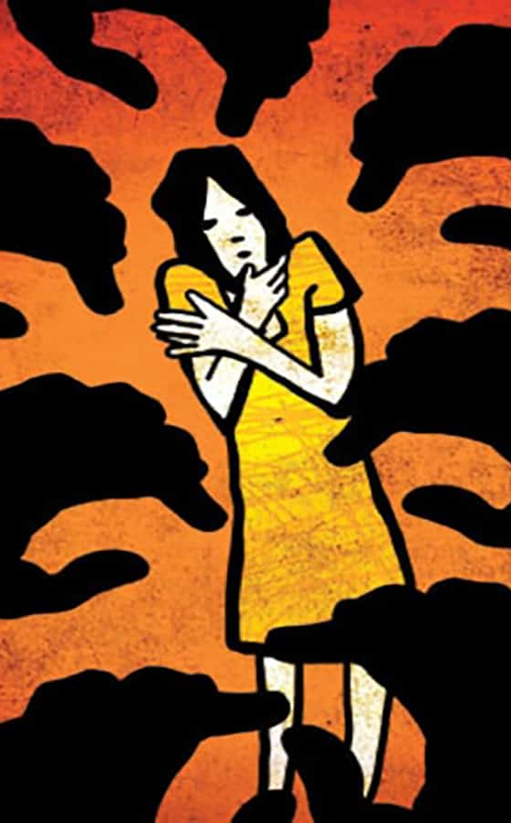
Gender Inequality
and
Crime Against Women
233 Not Found
Yingzi Jin, April Wang, Ruoyi Wu, Guangjie Xu
Caption

Slide 2
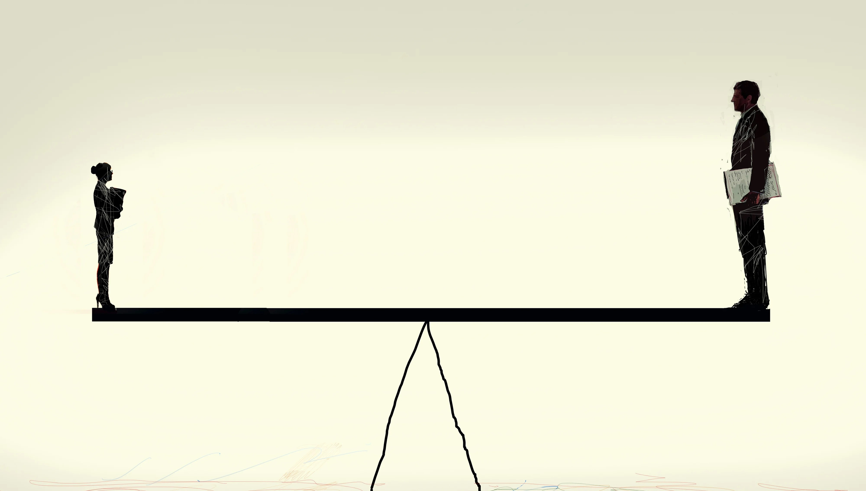
Background & Motivation
Caption

Slide 3

Introduction
Gender Inequality Background
Gender inequality
The unequal treatment and opportunities afforded to individuals based on their gender.
Changing societal structures of gender inequality across fields is essential to reduce crimes against women and limit men's use of violence against women (Yodanis, 2004).

Slide 4

Crime Against Women
Crime against women is a broad category that includes a range of offenses that disproportionately affect women, such as sexual assault, domestic violence, stalking, and human trafficking.

Slide 5
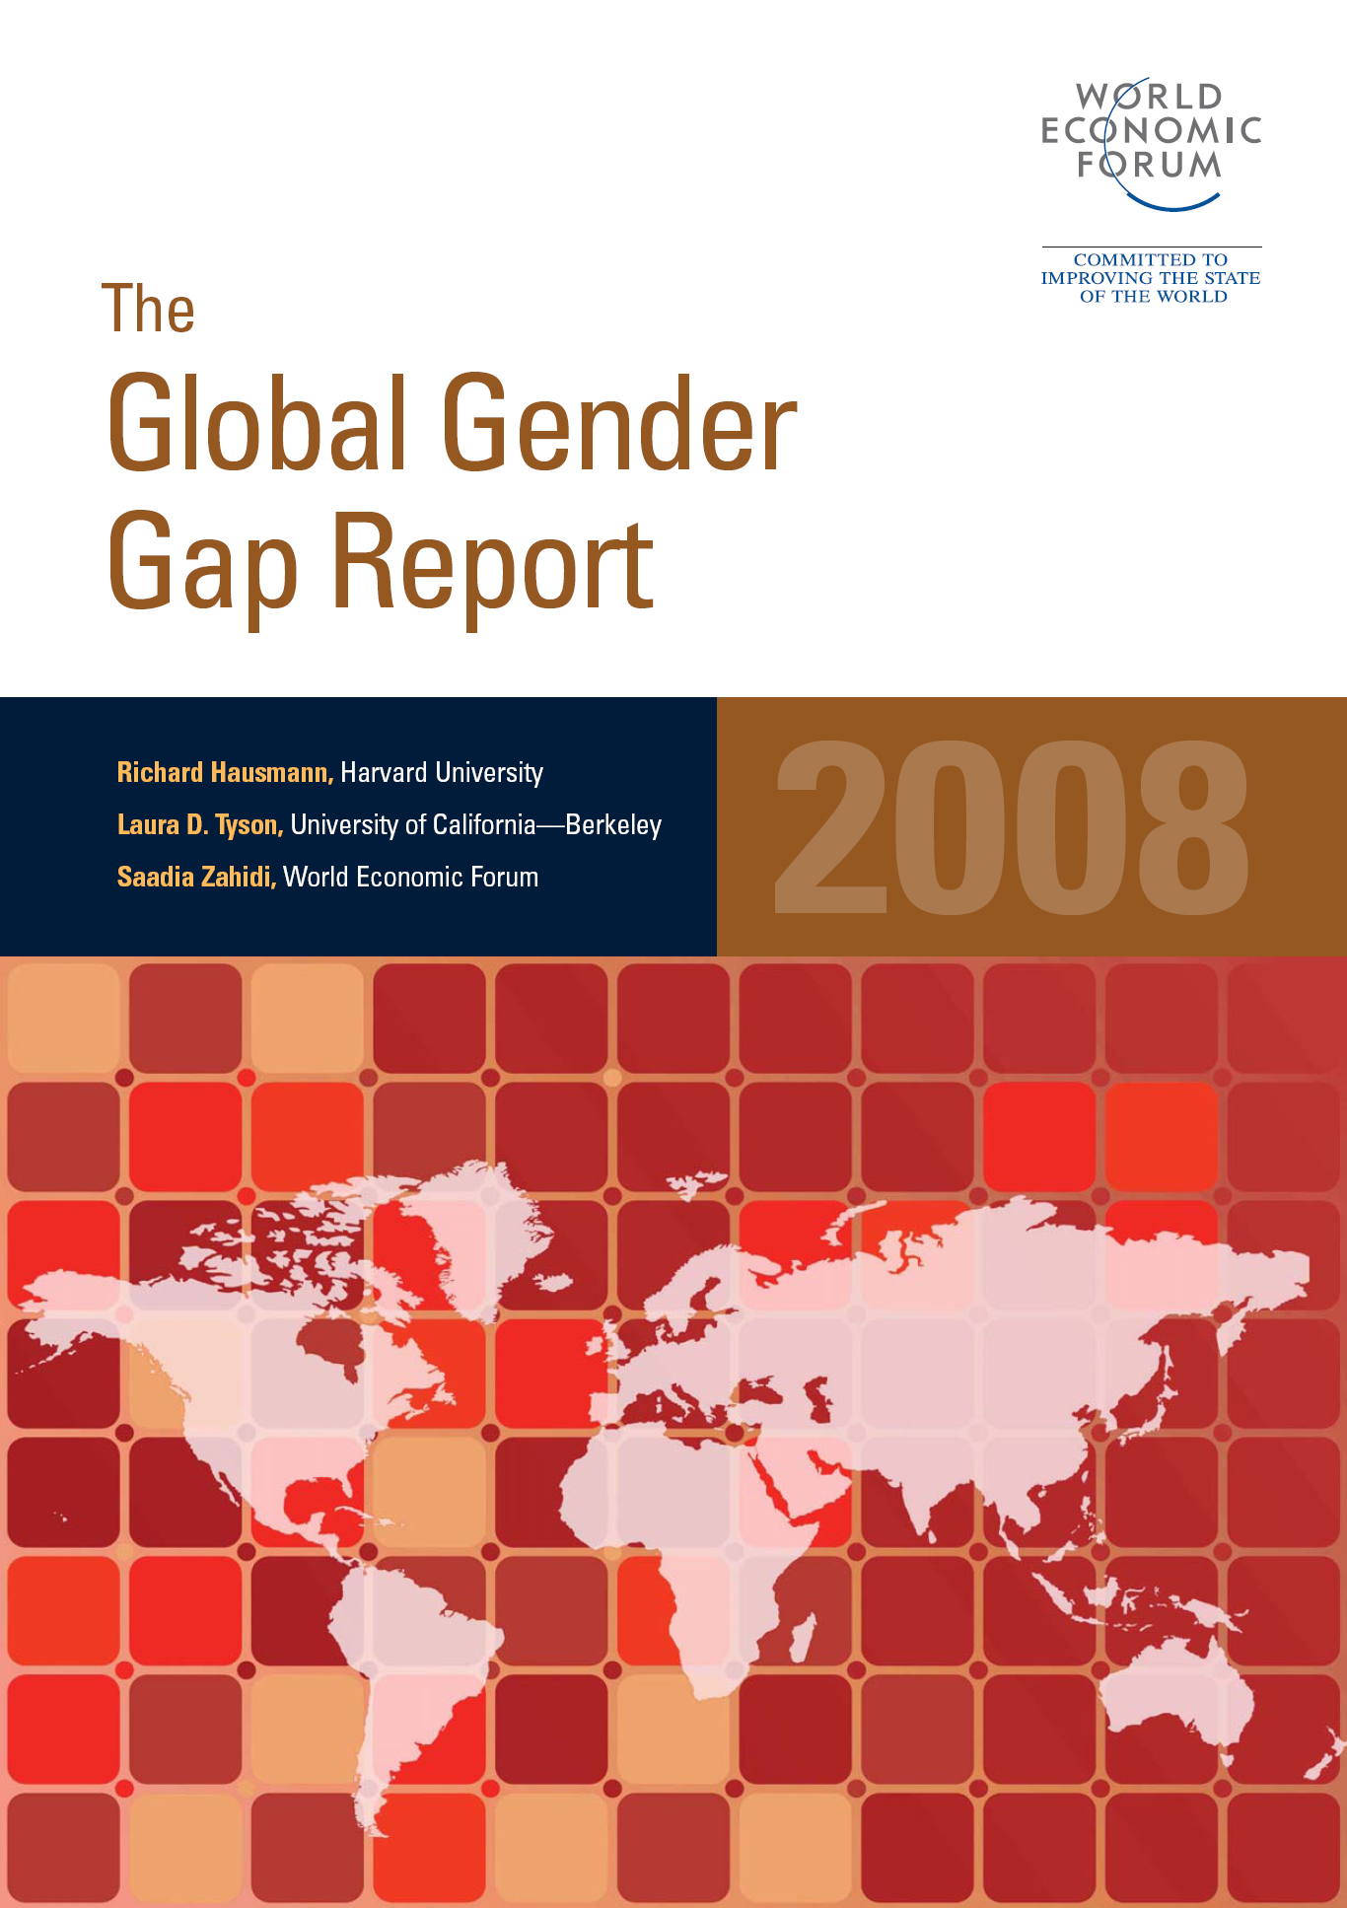
Motivation
The Global Gender Gap Report:
An annual publication by the World Economic Forum
4 key indicators: economic participation and opportunity, educational attainment, health and survival, and political empowerment
BUT not include crimes against women

Slide 6

Operationalization
Gender Inequality
Economic gender gap
Education gender gap
Health gender gap
Political empowerment
Abortion: state legality and abortion rate
Roe v. Wade in June 2022
Women’s autonomy over their bodies - freedom to make life choices
Crime against women: rape rate
Rape is a gendered crime that is overwhelmingly committed against women by men (about 90% of the victims are female)

Slide 7
Research Question
How does gender inequality, as measured by five key indicators (economic gender gap, education gender gap, health gender gap, political power, and state-level abortion laws), relate to the prevalence of crimes against women in the United States?
To what extent can the five key indicators be used as predictors of the prevalence of crimes against women in the United States?

Slide 8

Data

Slide 9

Data Collection
Economic Gender Gap
Labor force participation rate
Management position wage gender gap
Bachelor holder wage gender gap
Source: United States Census Bureau

Slide 10
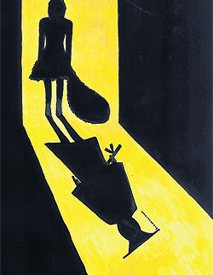
Data Collection
Education Gender Gap
Female and male population with highest degree of high school
Female and male population with highest degree of bachelor degree
Female and male population with highest degree of master or professional degree
Source: United States Census Bureau

Slide 11

Data Collection
Health Gender Gap
Sex ratio at birth: male per 100 female
Life expectancy ratio: average male life expectancy / average female life expectancy
Source:
United States Census Bureau
National Center for Disease Control and Prevention
US Mortality Rates and Life Expectancy by State, Race, and Ethnicity

Slide 12

Data Collection
Abortion Rate
Age range: 15 - 44
Abortion rate = (abortion occurrences / female population) * 1000
Source:
Centers for Disease Control and Prevention
Guttmacher institute
johnstonsarchive.net

Slide 13
Data Collection
Abortion Legality
Web scraped each state’s ruling and legalization of abortion
BeautifulSoup and Regex
From: wikipedia: abortion law in the U.S. by state

Slide 14

Data Collection
Female Political Empowerment
Ratio of women in state legislature
Whether the state governor or state lieutenant governor is female
Source: Center for American Women and Politics
Caption

Slide 15

Data Collection
Rape Rate
Rape rate = (rape incidents / population) * 100,000
Source:
Unified Crime Reporting Statistics under the collaboration of the U.S. Department of Justice and the Federal Bureau of Investigation information crime statistics

Slide 16
Data Collection Challenge
1. Strict and specific data category: requiring gender-, year-, and state-categorized data
2. We could not find a complete and longitudinal dataset of crimes against women across 50 states, so we used rape data instead
3. The CDC's dataset on abortion occurrences initially seemed complete, but when we graphed the abortion rate over time and by state, we noticed an unusual pattern. Upon closer inspection, we realized that some of the data was missing. We addressed this issue by supplementing the CDC's dataset with information from johnstonsarchive.net.

Slide 17

Data Preprocessing
Aggregate our 3 education gender gap indicators into one describing high school and higher education
Health: Life expectancy ratio m/f -> f/m
Econ: bachelor_wage_gap -> times (-1)
Drop sex_ratio_birth

Slide 18
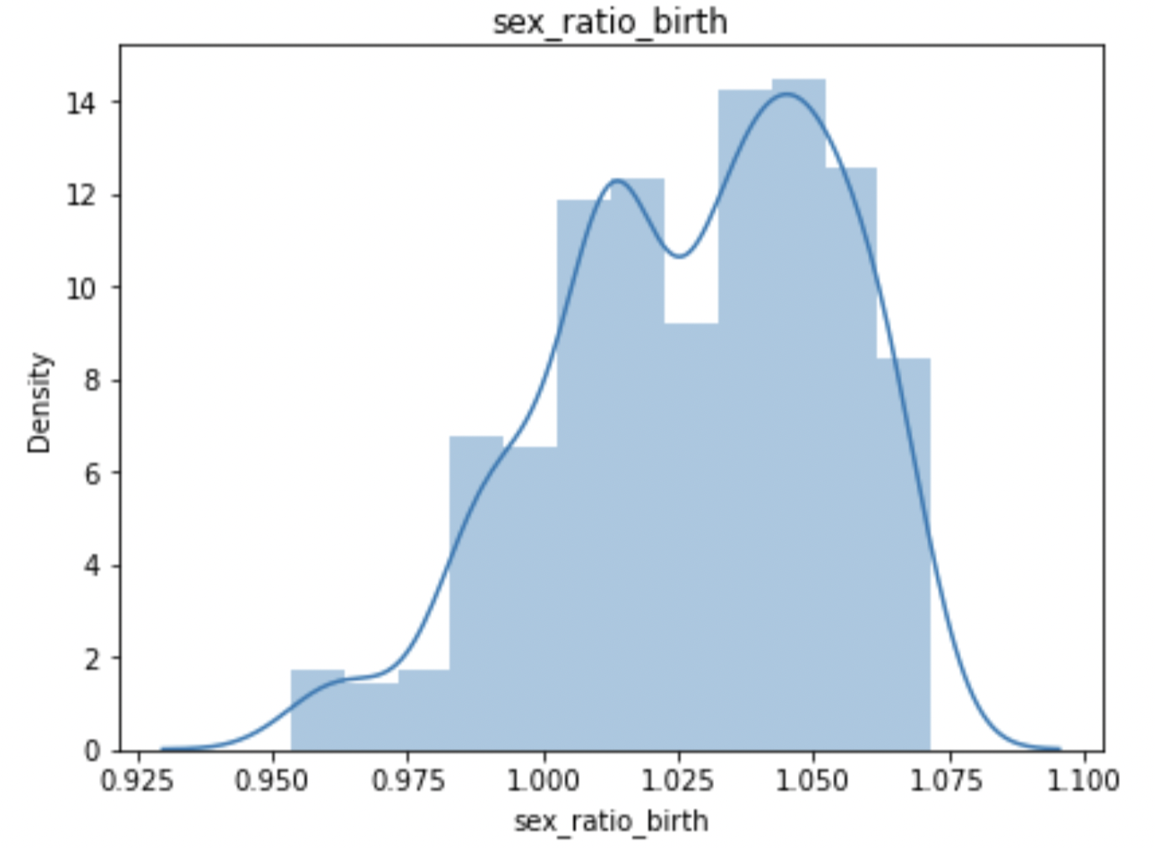
Data Preprocessing
Why did we drop sex_ratio_birth
A left tail and a mean > 1, indicating a higher proportion of female new-born babies than male in most states. This phenomenon defies a common culture of valuing male over female
Therefore, we don’t think sex ratio is indicative of health gender gap or rape rate, so in the following section we will drop this feature for better accuracy

Slide 19
Data Preprocessing
Aggregate the above three indicators into one describing high school and higher education
Health: Life expectancy ratio m/f -> f/m
Drop sex_ratio_birth
Drop mngmt_job_wage_gap

Slide 20
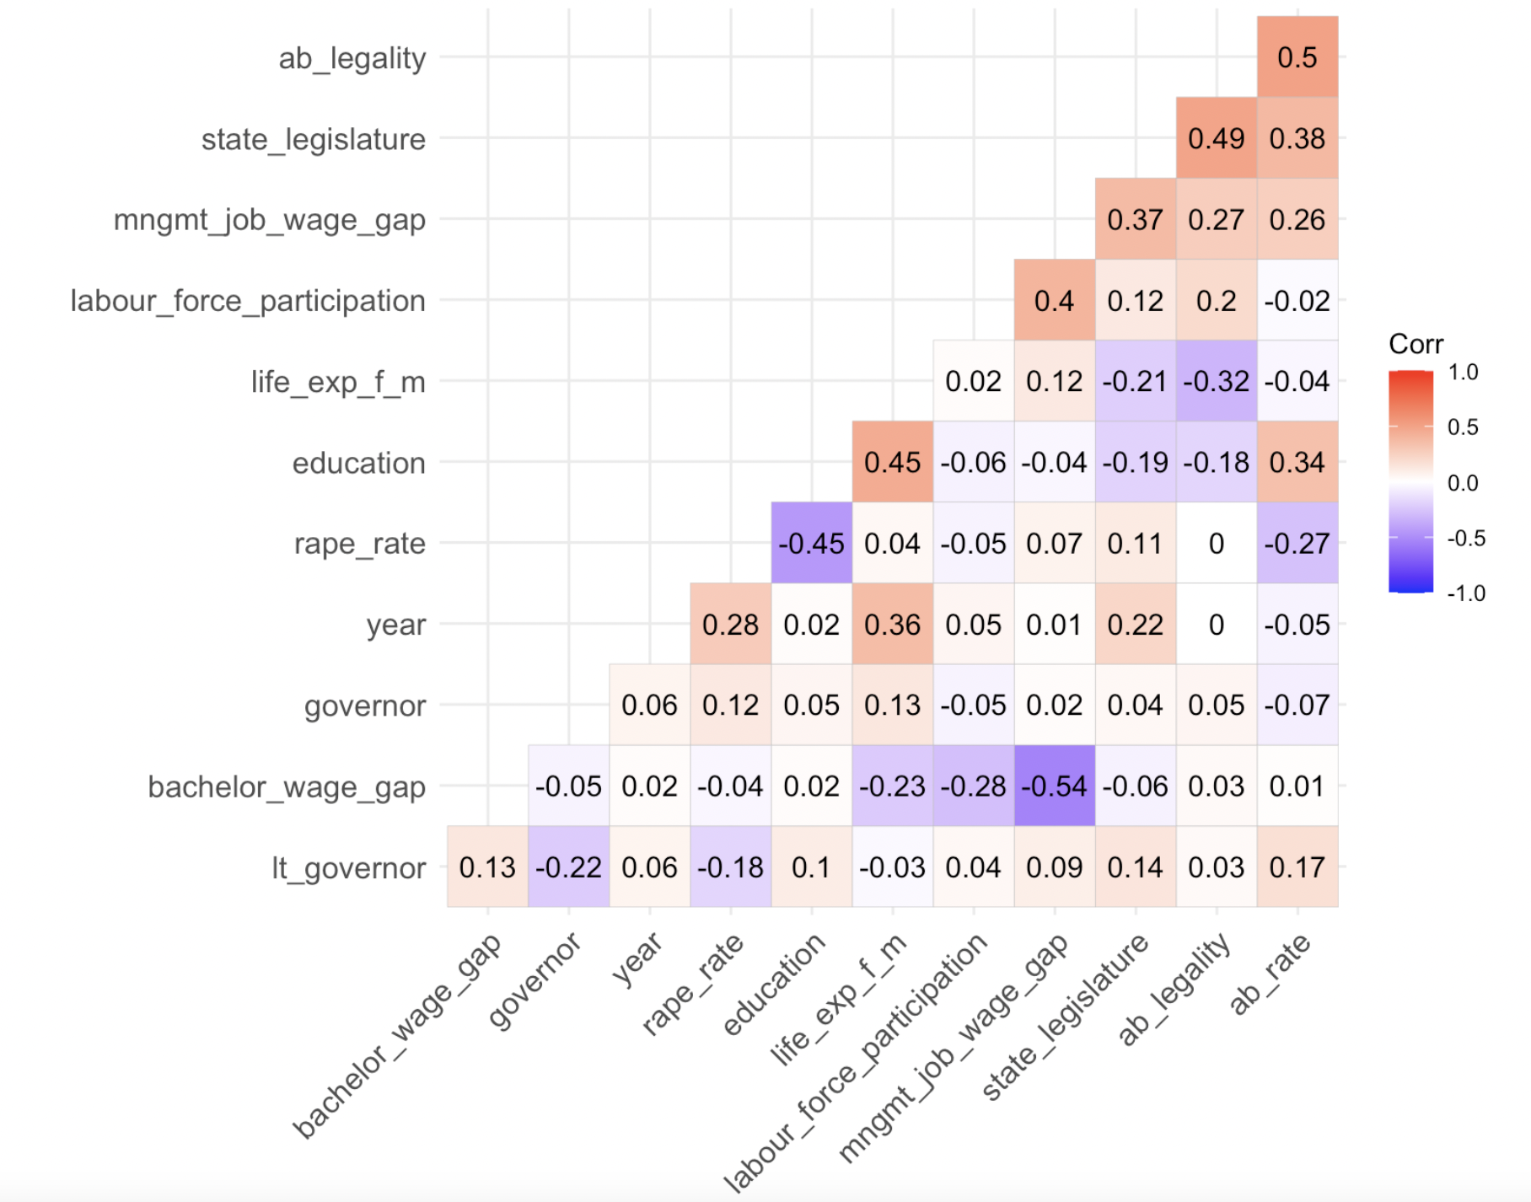
Data Preprocessing
Why did we drop mngmt_job_wage_gap
mgnt_wage_gap feature has strong correlation with bachelor_wage_gap
To avoid collinearity, we drop mgnt_wage_gap

Slide 21
Data Preprocessing
Aggregate the above three indicators into one describing high school and higher education
Health: Life expectancy ratio m/f -> f/m
Drop sex_ratio_birth
Drop mgnt_wage_gap
Political Empowerment
Use 1 to represent female state governor or female state lieutenant governor, 0 otherwise
Combine governor and lt_governor into state_gov

Slide 22
Data Preprocessing
Aggregate the above three indicators into one describing high school and higher education
Health: Life expectancy ratio m/f -> f/m
Drop sex_ratio_birth
Drop mgnt_wage_gap
Combine governor & lt_governor
state_gov
1: female state governor or female state lieutenant governor
0: otherwise
Use current abortion legality represent each state’s attitude for the last 10 years
Calculate the integrated gender gap index

Slide 23
Data Preprocessing
How did we calculate gender gap index?
Formula from World Economic Forum
Feature name: gap (0~1)
Lower index, higher level of gender inequality
Steps:
Calculate the standard deviation (sd) of each continuous indicator
Calculate sd per 1% point change
0.01/sd
Calculate the weighted average of all continuous indicators using results from Step 2 as weights
Each indicator has the same relative impact on the integrated index

Slide 24
state
year
education
labour_force_participation
bachelor_wage_gap
state_legislature
state_gov
life_exp_f_m
ab_rate
ab_legality
gap
rape_rate
Data Collection
11 Feature

Slide 25

Sample size = 50 states * 10 years = 500 rows
Advantage: Longitudinal and comprehensive dataset covering all states in the U.S.
Limitation:
Rape rate as sole representation of crime against women only captures a small portion of the wide range of gender-based violence and discrimination against women
We did not use all the sub-indicators in the World Economic Forum Report, so we might not provide a complete gender inequality landscape

Slide 26

Exploratory Data Analysis

Slide 27
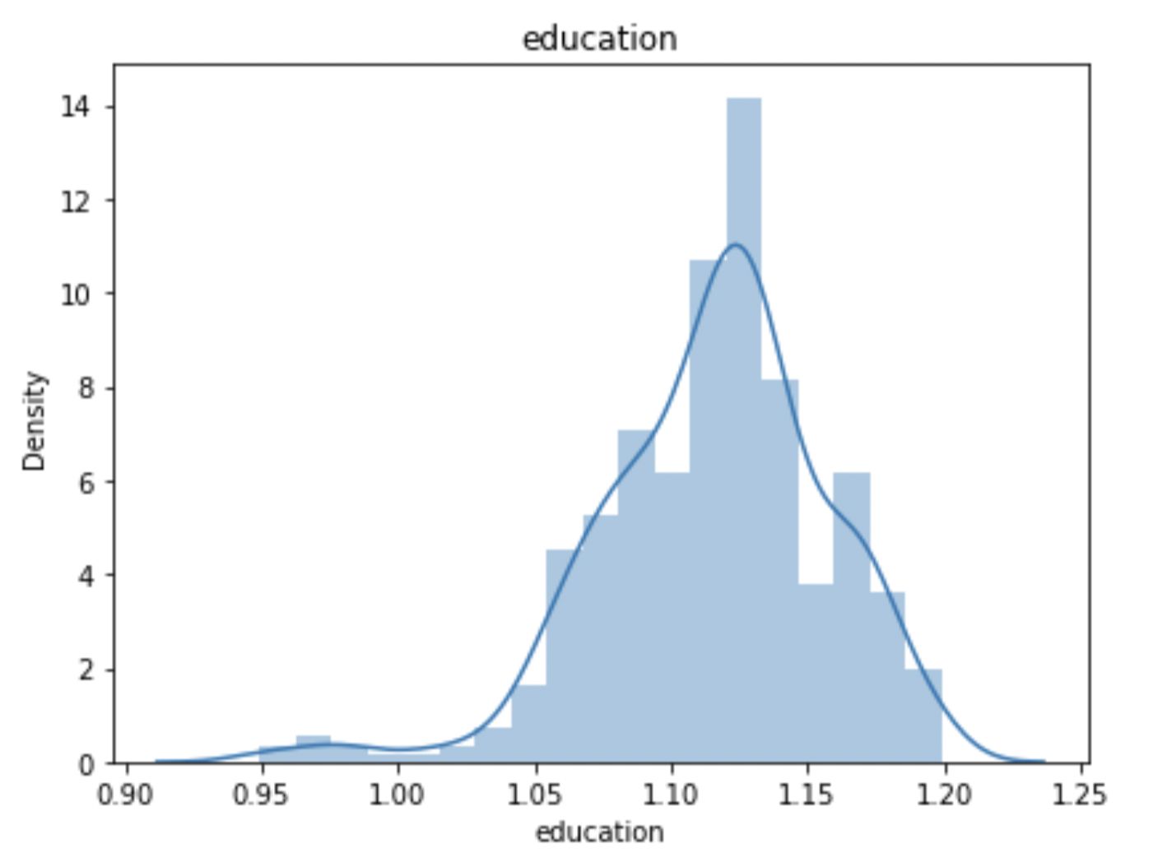
Feature Distribution Analysis
Education Gender Gap
The distribution of education gender gap shows a mean around 1.125 and a left skewness, indicating female population consists of a larger proportion of the total high school and higher education graduates
Conclude that female are more likely to pursue a higher education degree than male in general

Slide 28
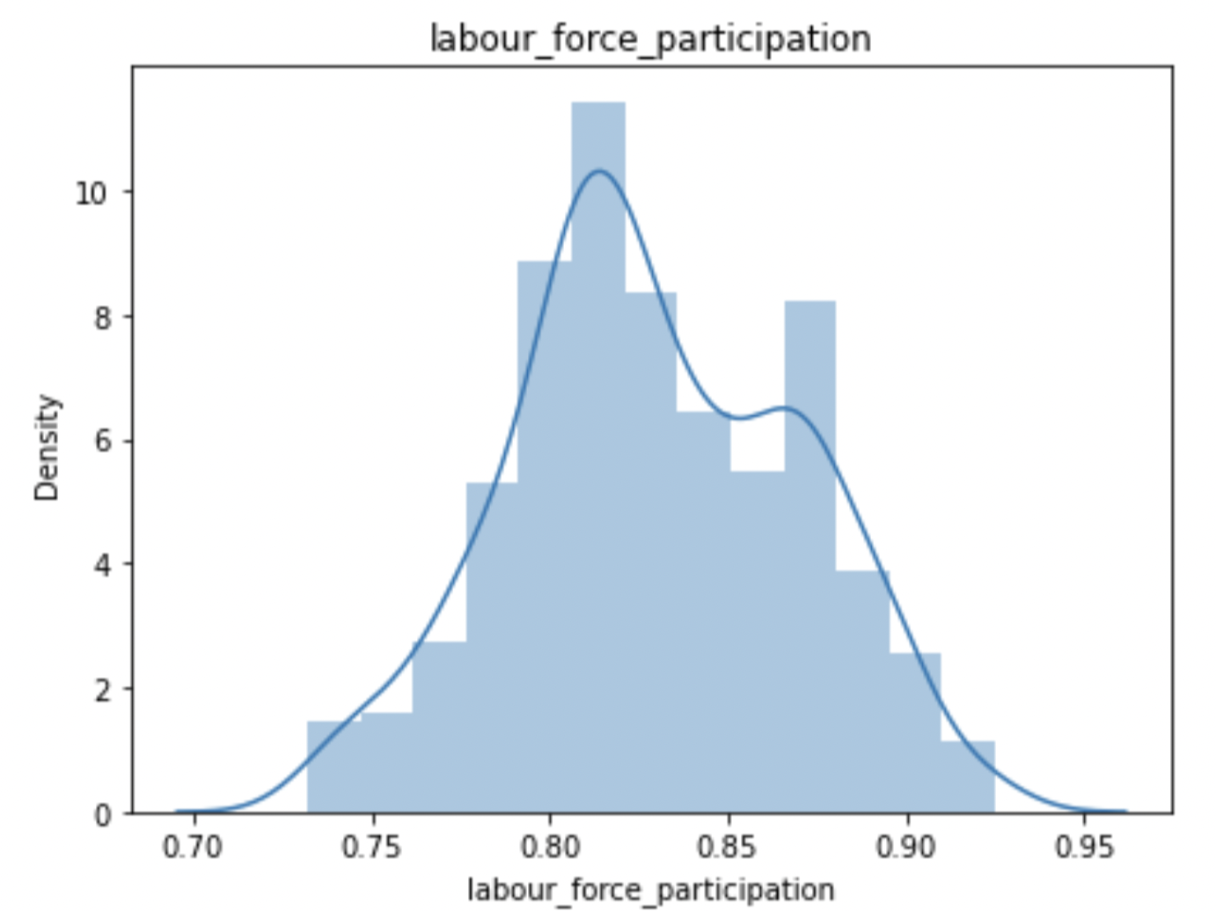
Feature Distribution Analysis
Economic Gender Gap
Labor force participation distribution has a mean around 0.825 and left skewness, indicating female's marginalization

Slide 29
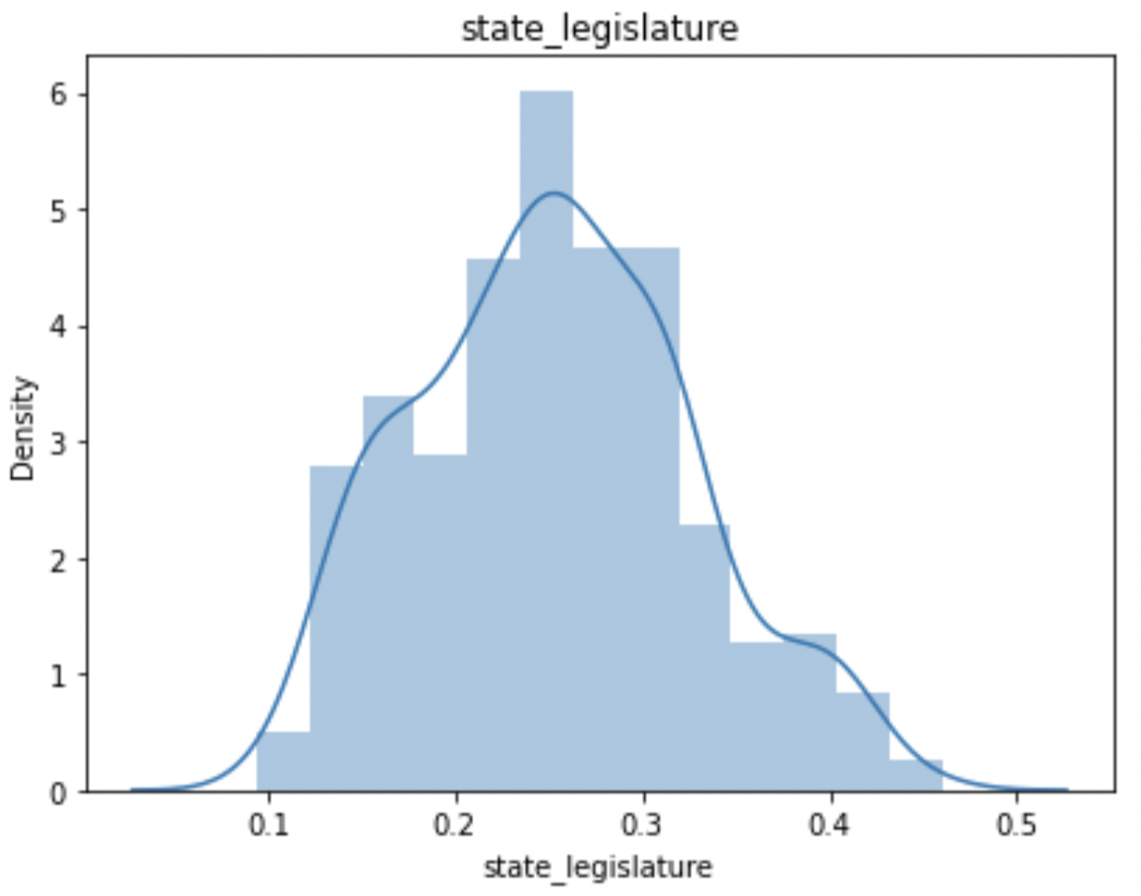
Feature Distribution Analysis
Political Empowerment
The distribution of state legislature of women has a mean of 0.27, which is critically low. This mean indicates that among all positions, of which female only occupy 27 percent.

Slide 30
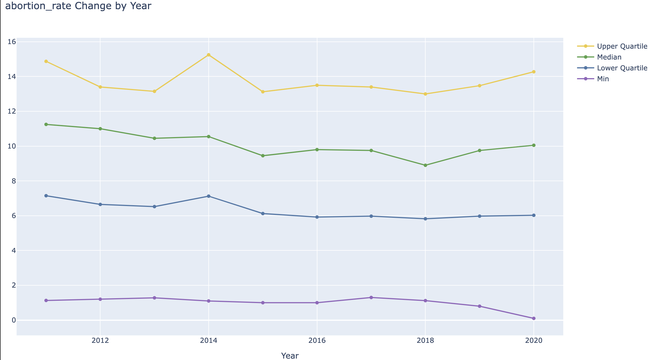
Longitudinal Trend
Abortion Rate

Slide 31
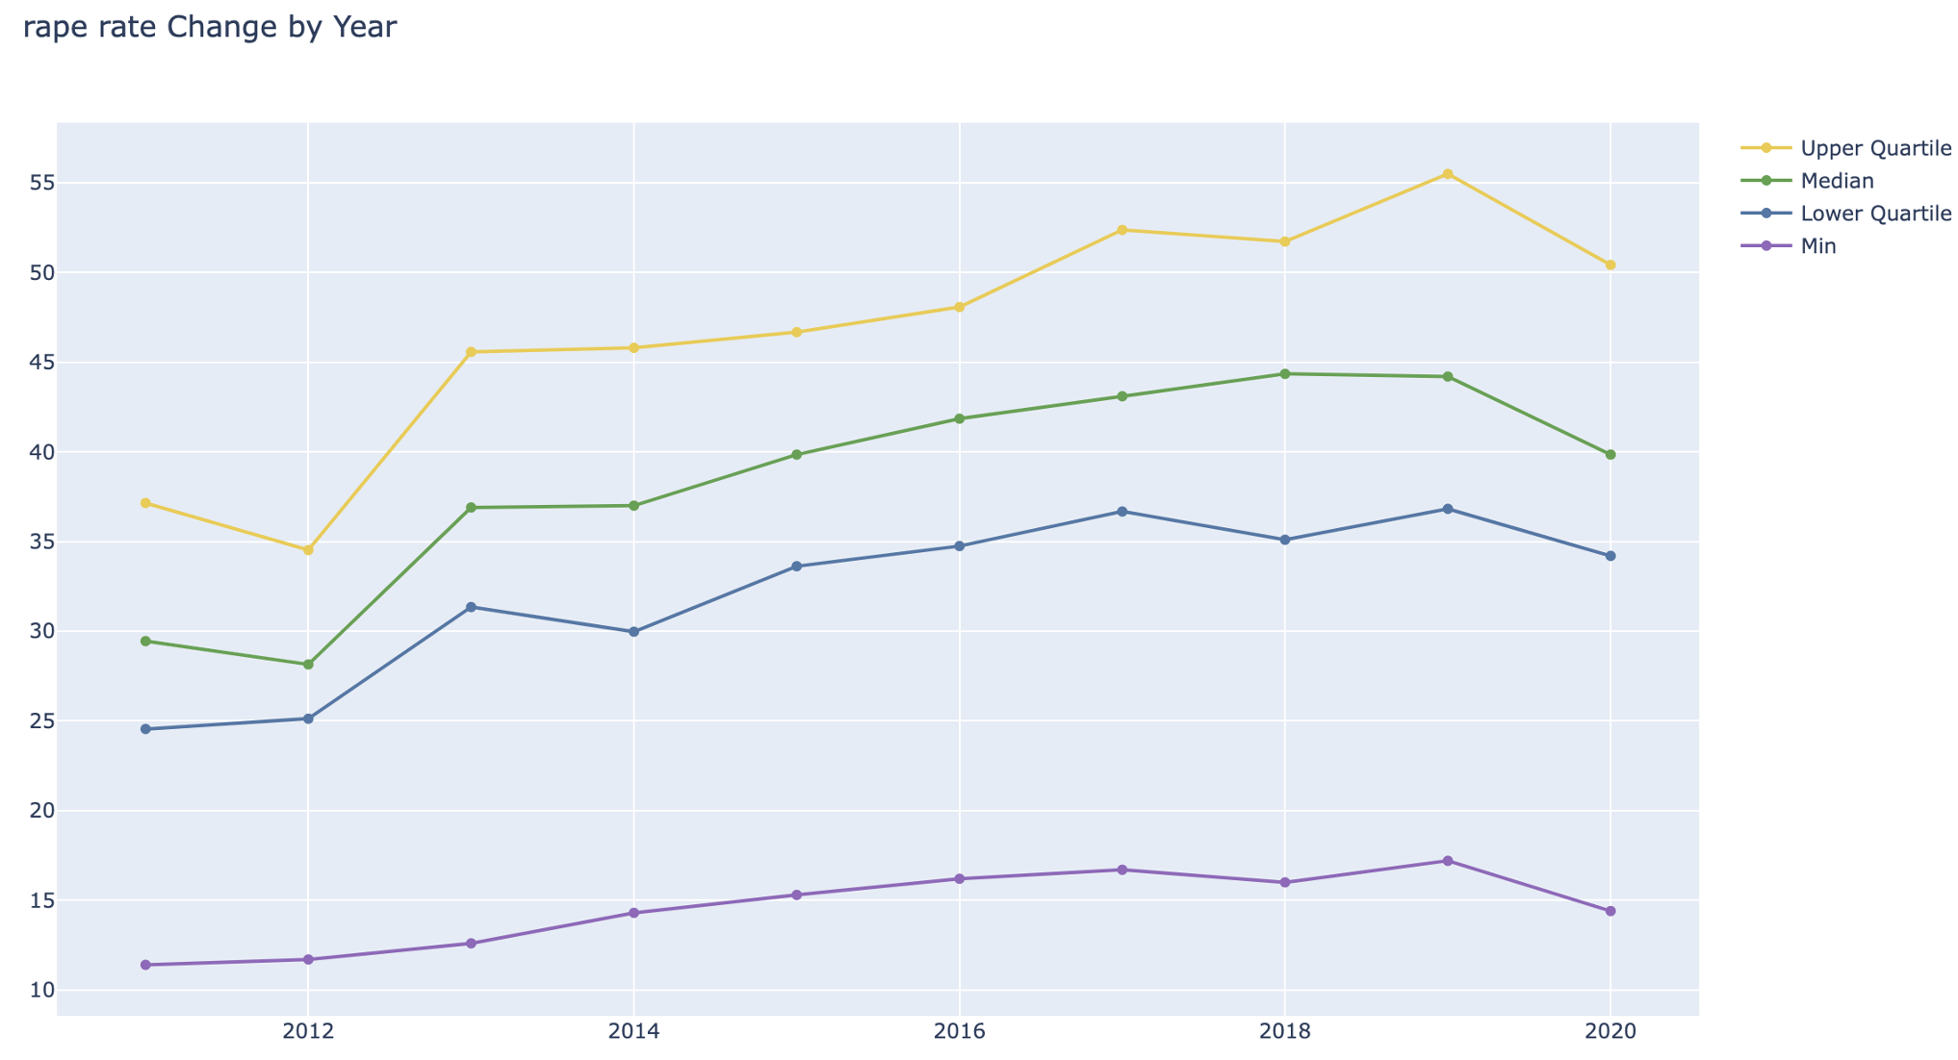
Longitudinal trend
Rape Rate

Slide 32
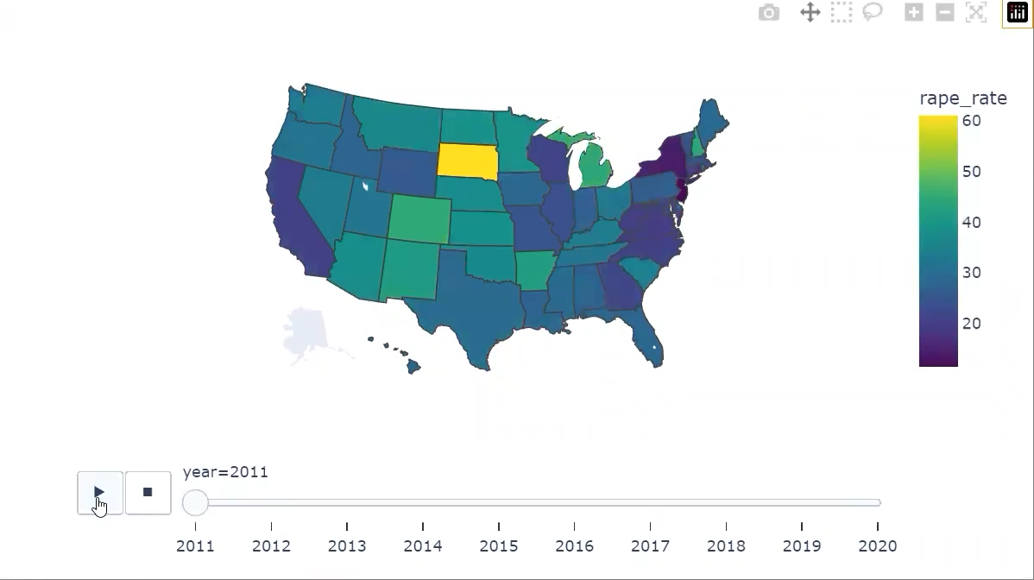
Rape Rate Across Years on Map

Slide 33

Statistical Analysis

Slide 34
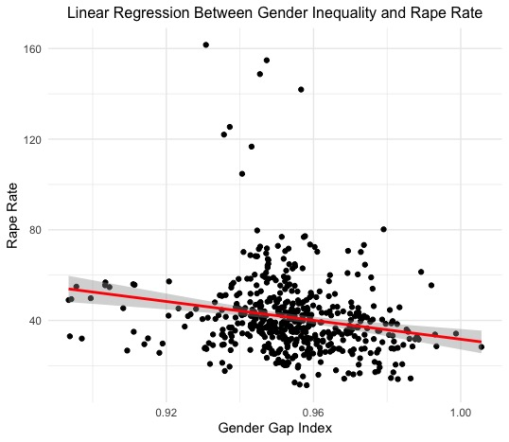
Higher Level of Gender Equality, Lower Rape Rate

Slide 35
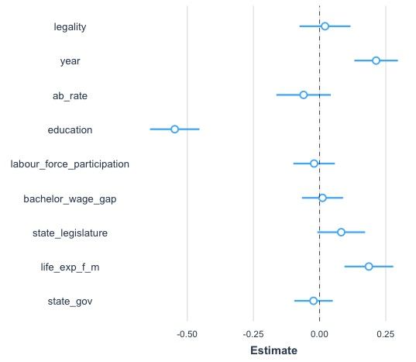
Multivariate Regression Model
All Indicators (scaled) without gap
vs. Rape Rate
Significant and Negative relationship with rape rate:
education
Significant and Positive relationship with rape rate:
year
life_expectancy_f_m

Slide 36

- Reported rape rate has increased from 2011 to 2020 as FBI extended the definition of rape from only male offender and female victom to both sexes.
With increasing attention to de-stigmatize rape victims, victims might be more willing to report cases.
Higher life expectancy of women might imply high mortality of young men -> lower level of public safety

Slide 37
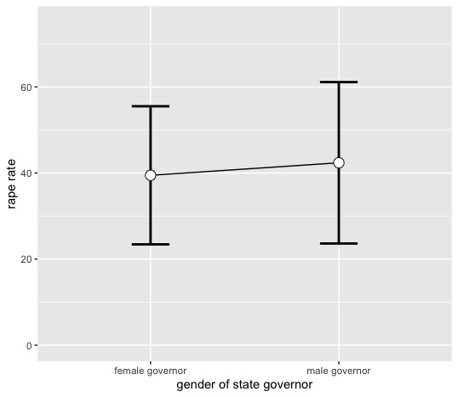
Female State Governors vs. Male State Governors
States governed by women have statistically significantly lower rape rate than the states governed by men

Slide 38

Predict Rape Rate
Machine Learning

Slide 39
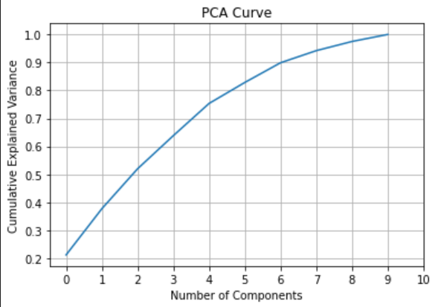
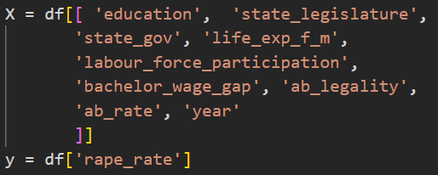
Dimension Reduction
Principle component: 6

Slide 40
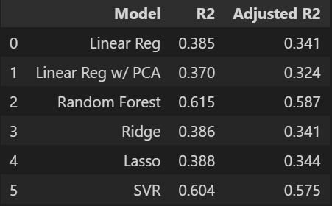
Machine Learning
Model Performance

Slide 41

Take Home Point I
Experience
Missing data - check for unusual pattern and caution mismatching data and label
Web scraping - cautious about HTML layout when scraping multiple pages at a time
R is much powerful in statistical analysis task and has better visualization packages than Python

Slide 42
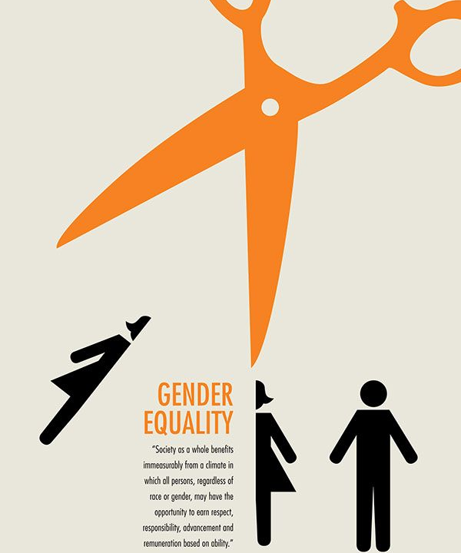
Take Home Point II
Revisit Research Question
Overall, higher gender inequality predicts lower rape rate
Specifically, large education, economic gap, lower level of political empowerment, or more restrictions on abortion is associated with higher rape rate.
Random forest model has the best performance on non-linear multivariate regression task

Slide 43
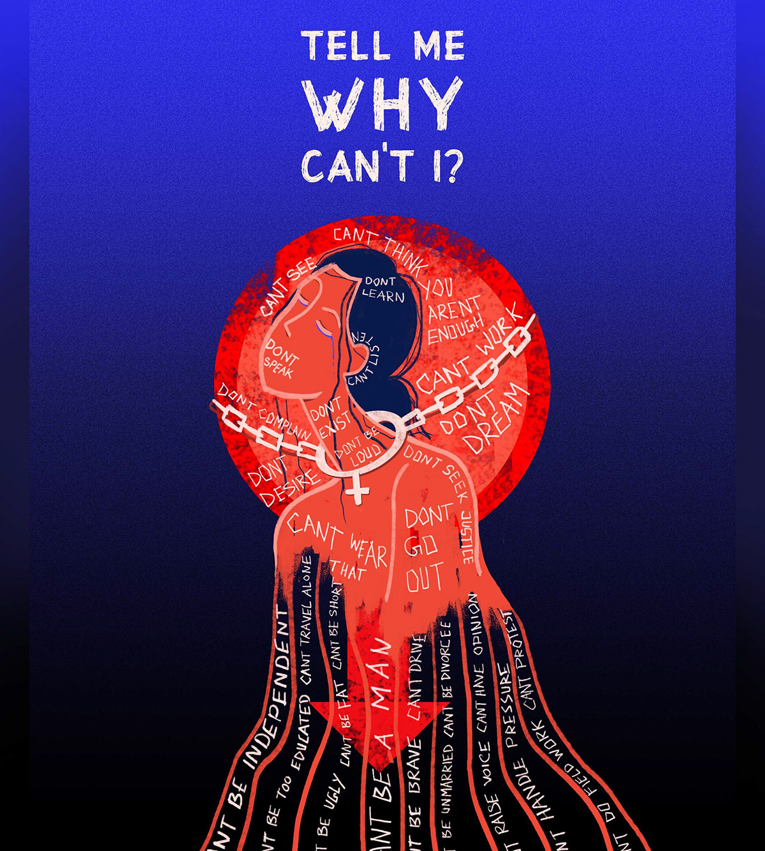
Q & A

